Slide 1
Fire Away Project
By Otis Schmidt

Slide 2
How is the spread of forest fires impacted by hills with different slopes and varying fuel density?

Slide 3
Introduction

Slide 4
Fire Among Us
70,000 forest fires burn an average of 7 million acres every year
Often directly influenced by human interaction, with close to 90% having some link to a man-made ignition point
Topography plays a significant role in fire behavior
Fuel that fire is burning through also impacts spread
How can this be modeled?
Notes:
Finally, the type of fuel the fire is burning through contributes to the speed, flame size, and temperature of the fire. Larger fuels, such as trees and heavy slash (fallen branches, brush, etc.), burns hotter, with larger flame sizes than smaller fuels such as grass and thin brush (spread out over a larger area) (3). Historically, forests have contained roughly 50-70 trees per acre, while today, in some parts of the United States, forests contain anywhere from 500-1000 trees per acre (4) Talk about attempting to achieve overcrowding, slope variance, vegetation randomness

Slide 5
Goal

Slide 6
Model a variety of fire behavior when interacting with different hills and fuels.

Slide 7
The Model
Generate a two-dimensional grid that assigns each cell a value of either empty, a tree, or an active burn designation
Constants: probabilities for a lightning strike, new tree growth, vegetation, as well as the fraction of the forest that is already occupied by trees
The Hill: two-dimensional Gaussian distribution function:
f(x, y) = Aexp(−((x−xo)^2/(2σ_X^2)+(y−yo)^2/(2σ_Y^2))
Notes:
Talk about colors for grid, how we change the constants in different trials, and how the slope is just inaccurate enough

Slide 8
Numerical Methods
-Gaussian Distribution: calculation of x0, y0, x and y distributions, and slope calculations
-Vegetation Distribution: equal probability of significant fire, or “empty” space
-New Tree Growth and Lightning: random number generator versus probability

Slide 9
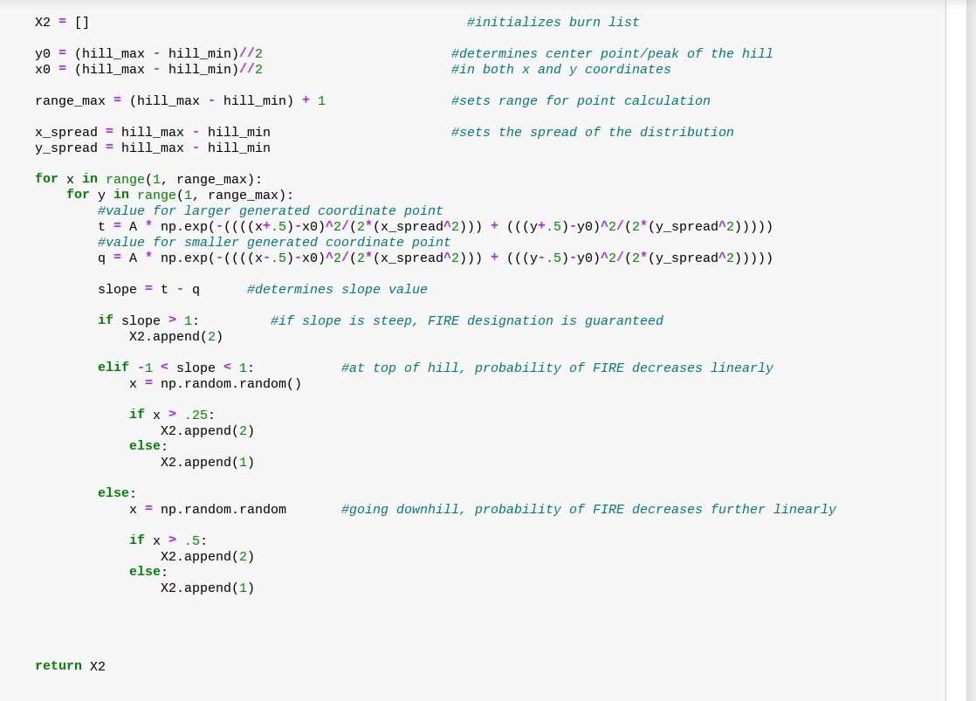
Code

Slide 10
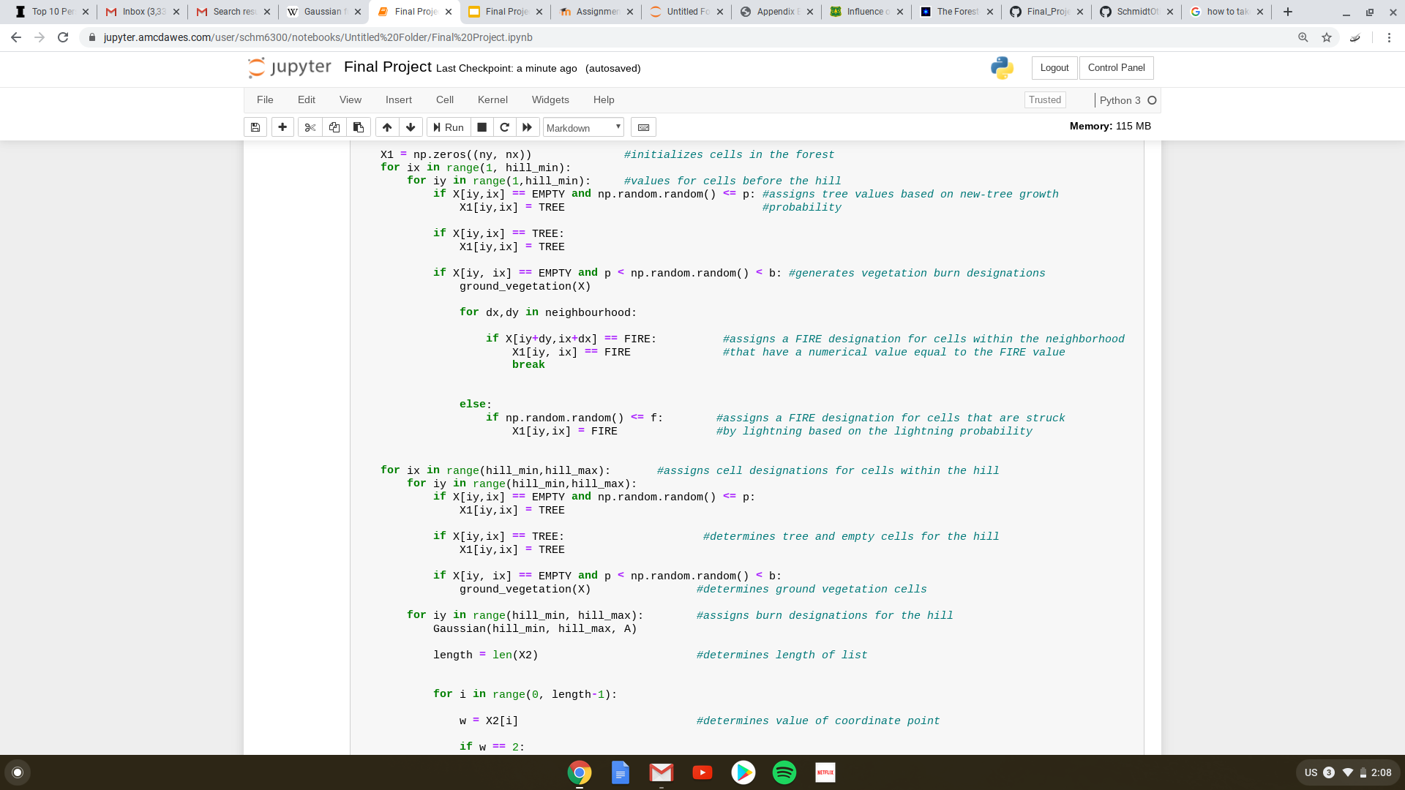
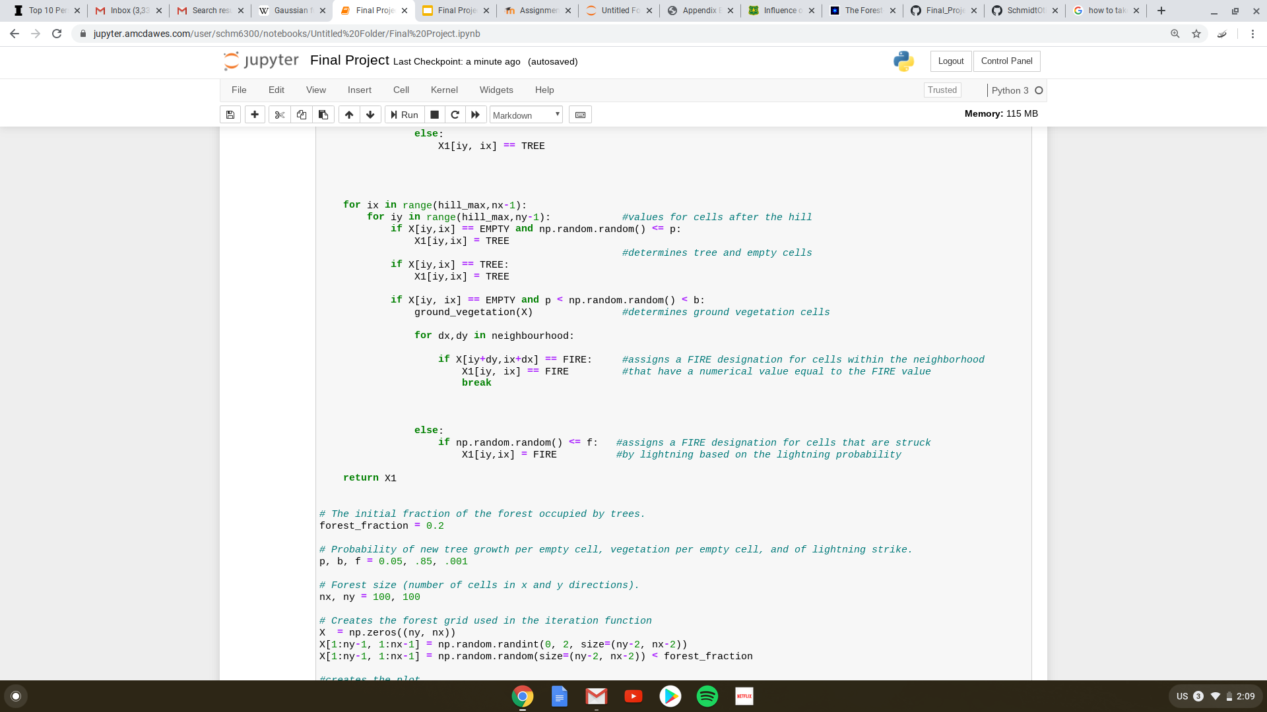
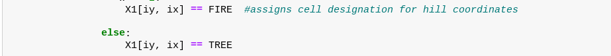

Slide 11
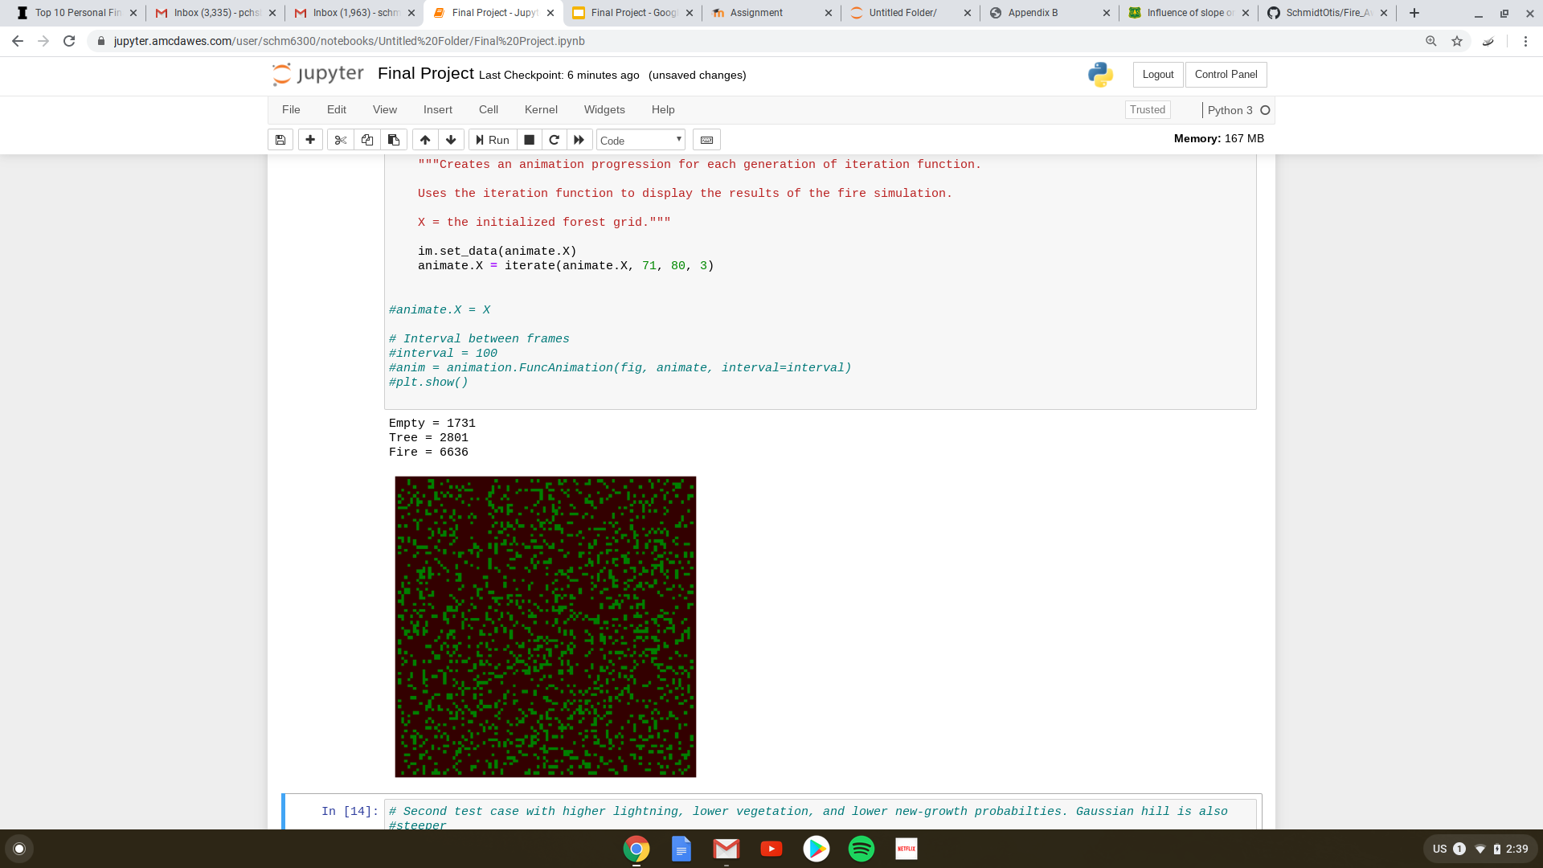
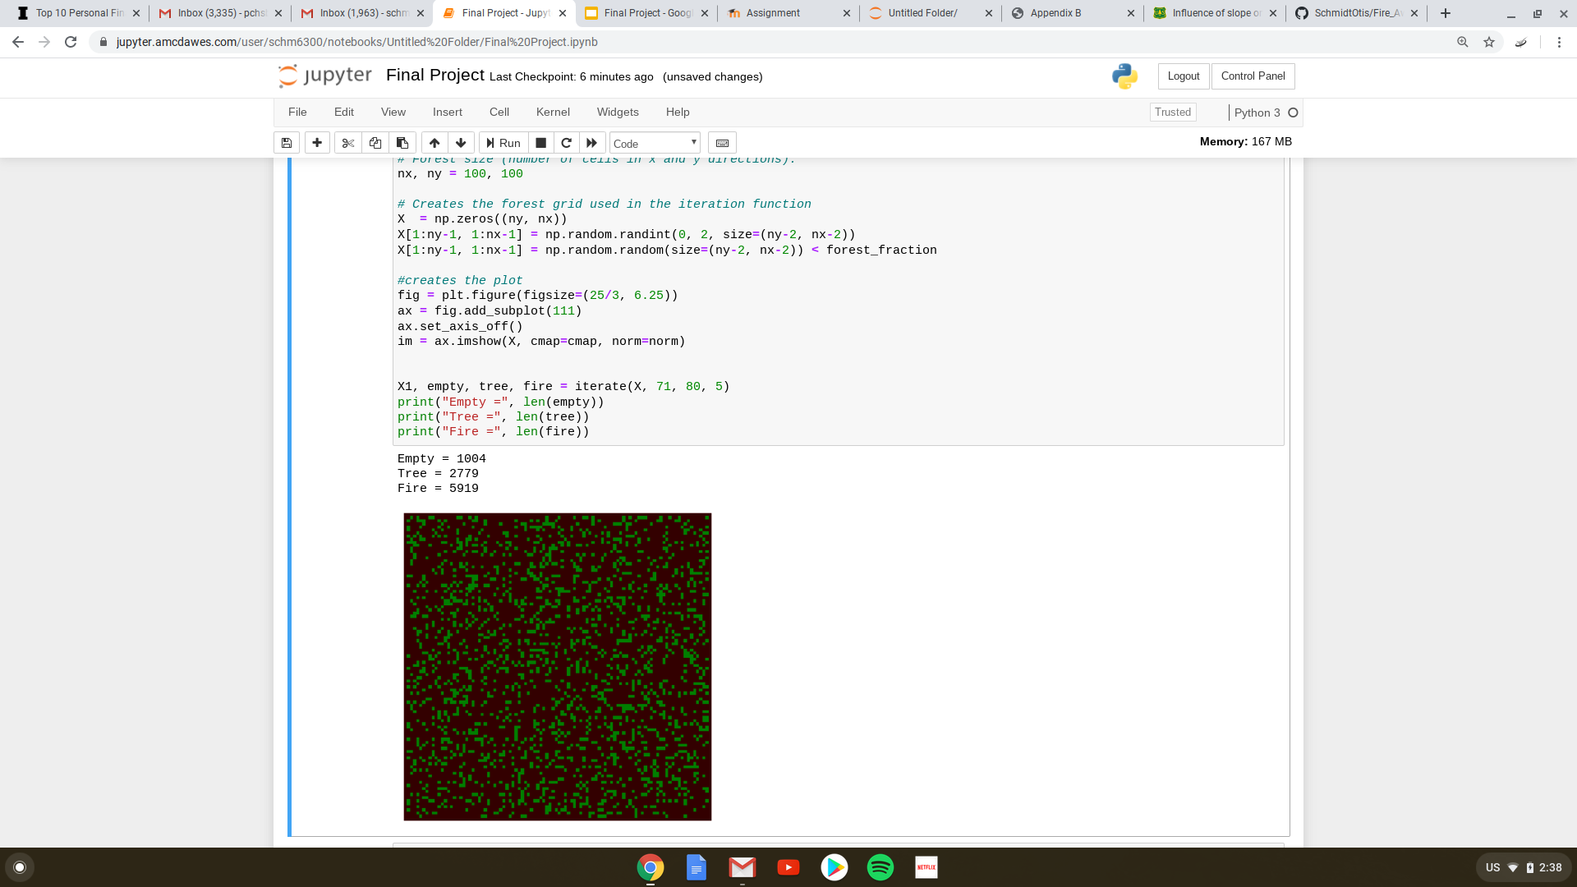
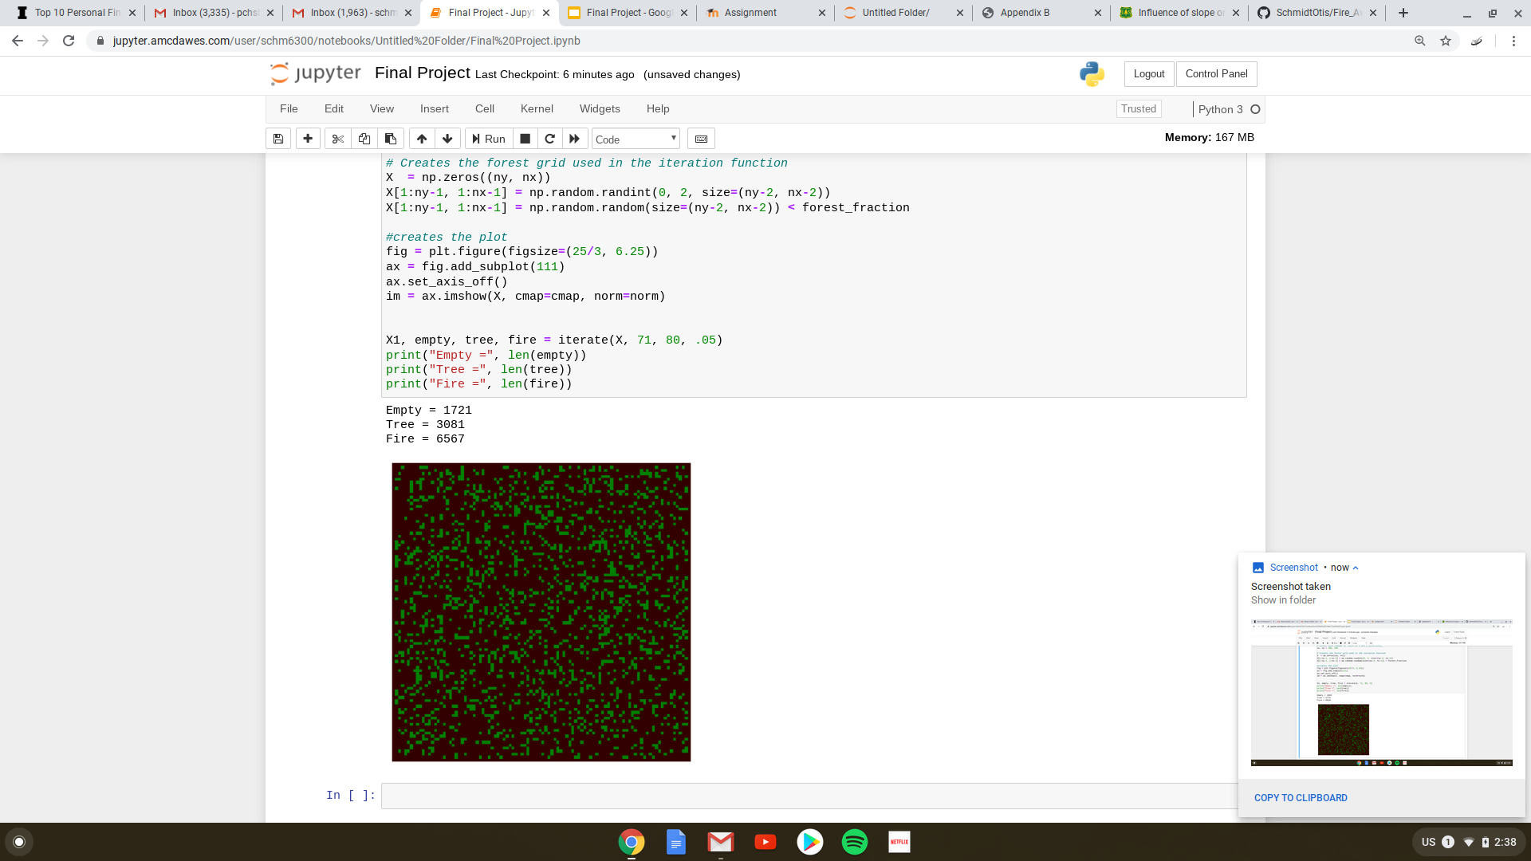
Results
Notes:
What do these mean? 1. Base case, 2. Higher lightning, lower vegetation and new tree growth, steeper slope 3. Lower lightning, higher vegetation and new tree growth, less steep slope

Slide 12
Analysis
Reasonable results?
Significant findings: Slope and fuel quantity, not necessarily type, more important than ignition point
Notes:
Just bs this, steeper slope is also significant for downhill portion, could significantly curb tree burning, no matter the fuel, in this simulation, the more occupied spaces, the more significant the fire

Slide 13
Summary
Scientific:
Proved that forest density is very significant, relevant for forest mitigation, as well as fire safety on hills for firefighters
Personal:
How to work through grids, amazing to be able to model real-life issues

Slide 14
References
Appendix B Fire and Fuels, National Geographic Area Coordination Centers, Fire Behavior Fuel Model Descriptions, (2001).
Influence of slope on fire spread rate, B.W. Butler, W.R. Anderson, E.A. Catchpole, The Fire Environment-Innovations, Managementm and Policy: Conference Proceedings (P), (2007).
Wildfire Statistics, K. Hoover, L. A. Hanson, Congressional Research Service (34), (2019).

